Slide 1
Introduction to Object-Oriented Programming
By Abeeha Sattar

Slide 2
You Already Know the Intro…
But… Let’s go over the goal for the course!
In this course, we’ll be learning…
  How to think in an OOP way. (what is the OOP way?)
  How to map real world into a program
  How to program a real-world scenario.

Slide 3
Programming Paradigms
Paradigm = a way/method to solve a problem
The term programming paradigm is used to specify an overall approach to writing program code
Some languages support multiple programming paradigms; e.g. C++, Python allow you to code in either paradigm.
  Let’s have a look at the paradigms…

Slide 4
Sequential Programming
You started in PF this way…
A sequence of statements is written in order to accomplish a specific activity.
Example: Write a program to calculate the cube of a number. (without functions, just main)

Slide 5
Procedural Programming
You moved to functions somewhere down the line in PF.
Functions are also known as procedures.
The procedural programming paradigm is where program code is divided up into procedures.
A function is a discrete block of code that carries out a single task.
Now then, write a function that calculates the cube, then call it from main.

Slide 6
Benefits of Procedural Programming
IDK, you tell me…
It makes things:
  Easier to reuse – function is in one place, and you may call it in multiple places.
  Easier to debug – e.g. complex formula you rewrote in two places and one is wrong… you don’t know which one… better if you had one function.
  Easier to manipulate data – you know what arguments you are receiving, which ones you want to modify and which ones you don’t want to modify.

Slide 7
Object-Oriented 👻 Programming (OOP)
It is a bottom-up approach.
The focus is on identifying and resolving smallest problems (objects) and then integrating them together to solve the bigger problem.
Procedural programming languages follows a top-down approach
The focus is on breaking the bigger problem into smaller one and then repeat the process with each problem.

Slide 8
Object Orientation
Think of a system, and think of what things are interacting with each other.
The classic most example is the ATM – Let’s think!
Another one, is a car.
Attributes
Behavior (operations)
Identity

Slide 9
Object-Orientation - Advantages
People think in terms of objects
OO models map to reality
Therefore, OO models are:
Easy to develop
Easy to understand

Slide 10
Object this, Object that…
But what is an object? Some definitions if you wanna ratta…
An object:
Can be anything for which we want to save Information
Is something tangible (Person, Car)
Is something that can be captured intellectually (Time, Date)
An object has:
States / attributes / properties / data
Well-defined behavior / methods / functions
Unique identity

Slide 11
Technical Definition of an Object
“An Object is an Instance of a class”
“An Object is the implementation of a class”
Any tangible thing for which we want to save Information

Slide 12



Object Example: Airplane

Slide 13
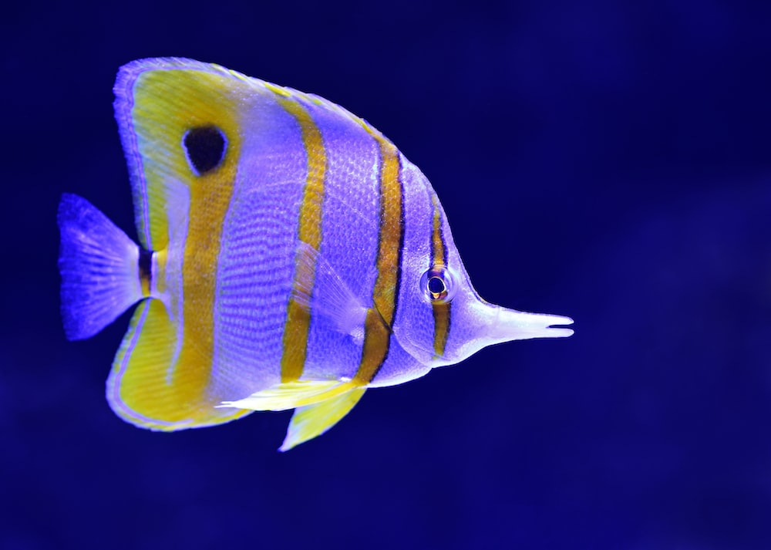
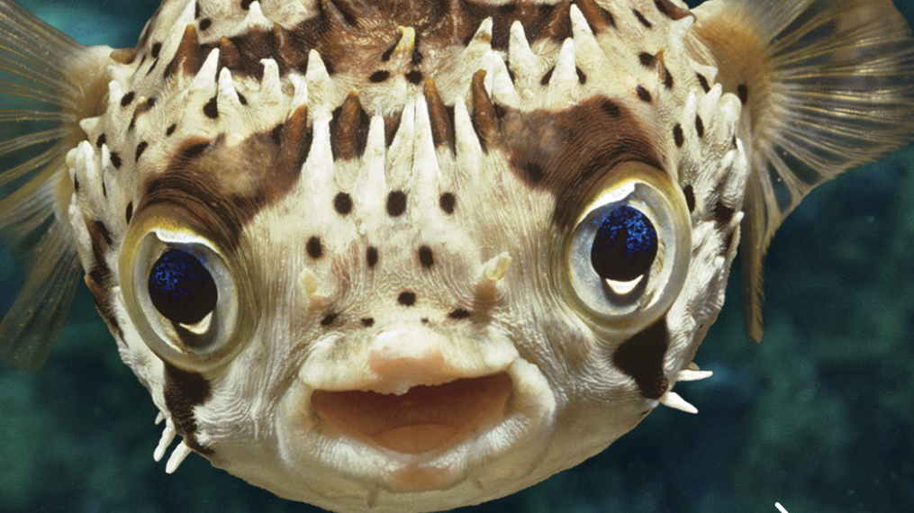

Object Example: Fish

Slide 14
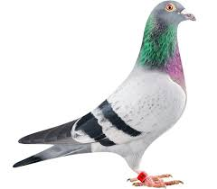
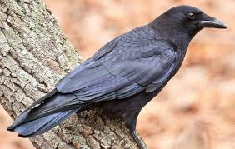
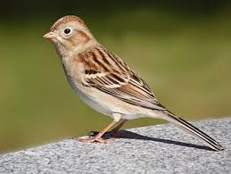
Object Example: Bird

Slide 15
So, in the previous examples…
What are the different types shown? Are they a class or are they an object?

Slide 16
Class
A class is:
A collection of similar objects.
The design of an object.
Details of an object.
Tells us what an object contains.

Slide 17
You might also see these terminologies…
A class :
It’s a blue print .
It’s a design or template.
An Object:
It’s an instance of a class.
Implementation of a class.
NOTE: Classes are invisible, object are visible

Slide 18

Thinking of Stuff as Classes and Objects…
(Home Tasks) – As discussed, think of attributes, functionalities and unique identities. What will their objects be? Come but with 3, minimum.
Smartphones
Washing Machine (automatic)
Student
Cat
Videogame Character
Netflix Account

Slide 19
Principles of OOP (An Intro)
Abstraction: To have the relevant information.
Encapsulation: To hide information inside the object.
Polymorphism: To have many shapes / behaviors.
Inheritance: To create a new object with an existing one (To adopt features from others)

Slide 20
Fin.
:D

